Slide 1
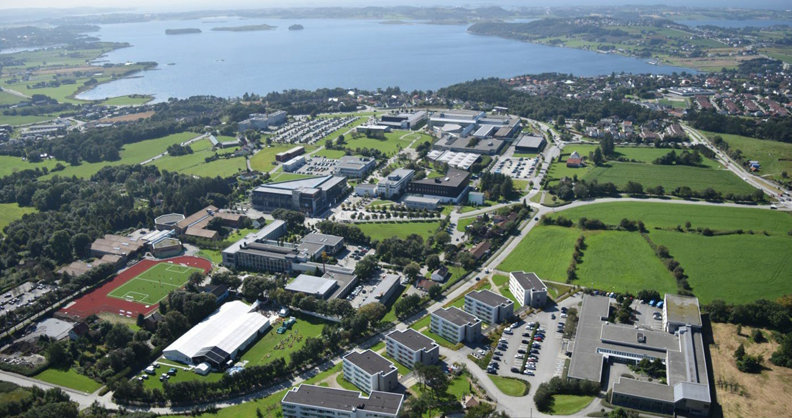



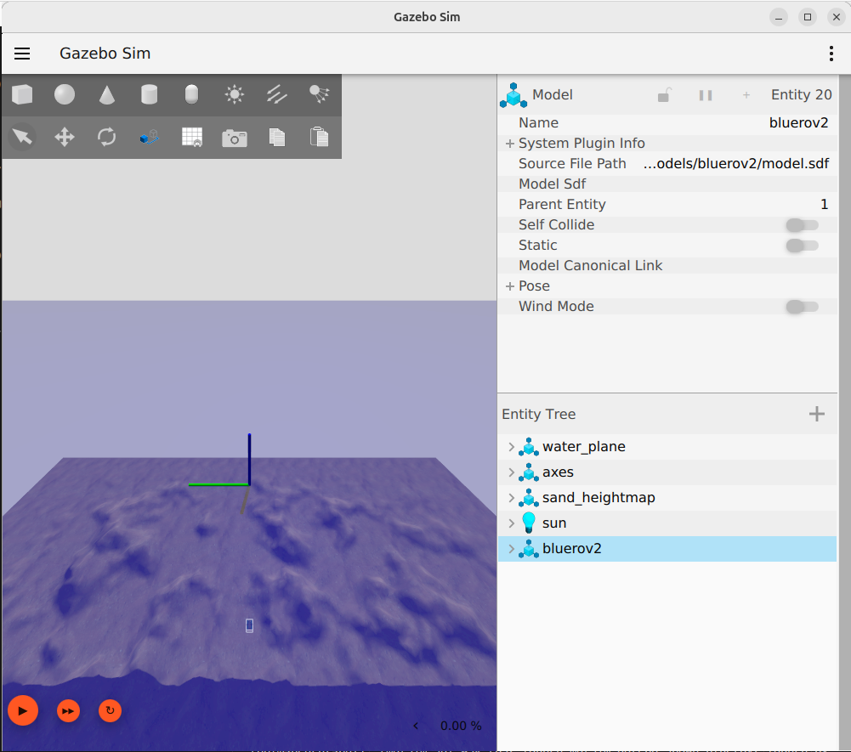
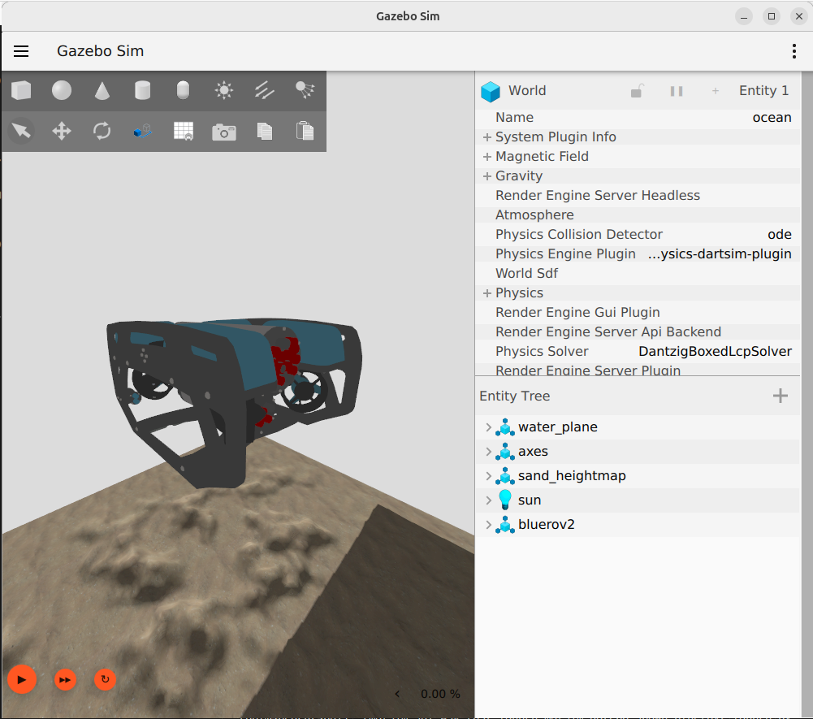
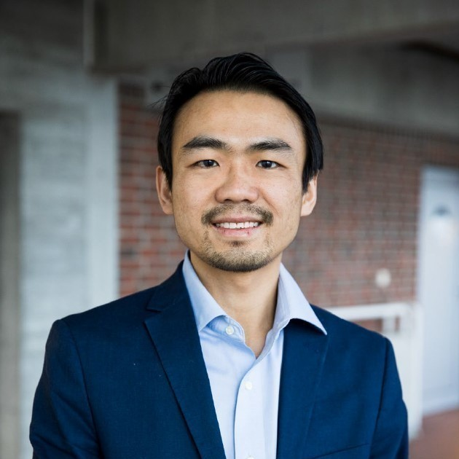
Welcome to Stavanger/Norway University of Stavanger uis.no
Bente Dale, International Office
An international university campus across 1300 acres of land
ROS 2-Gazebo - Marine Simulator v1.2
Professor Yihan Xing
Study program leader, MSc Marine and Offshore

Slide 2
Updates from MARSIM v1.1
Corrected DVL sensor mounting
marsim_gazebo
New launch files
launch/complete_simlaunch_bluerov2.launch
marsim_control renamed to marsim_control_py
Structured as a Python package
New scripts:
scripts/bluerov2_pid_disp_xyyaw_control.py
scripts/bluerov2_pid_disp_z_control.py
scripts/bluerov2_stop_thrusters.py
Updated scripts:
scripts/bluerov2_pid_pose_z_control.py

Slide 3
Updates from MARSIM v1.1 (2)
New bluerov2_ctrl_serv_py
Action servers and clients
pid_abs_yaw
pid_disp_z

Slide 4
Corrected DVL sensor mounting
Vel_x and Vel_y were inverted
Fixed by changing <pose degrees="true">0.0 0 -0.12 0 0 180</pose> to <pose degrees="true">0.0 0 -0.12 0 0 0</pose>
Pos_x and Pos_y from the EKF was inverted
Fixed by deleting <reference_frame>0 0 0 0 0 -1.570796</reference_frame>

Slide 5
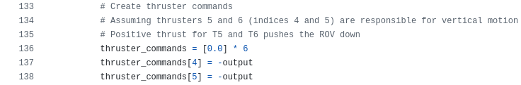
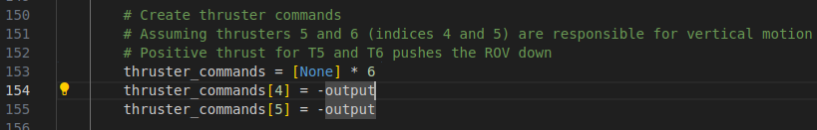
Updated scripts/bluerov2_pid_pose_z_control.py
The script will now not send any commands now to T1, T2, T3 and T4.
This allows T1 to T4 to receive commands from xyyaw controls without any conflicts

Slide 6
Planned updates for MARSIM v1.2
Add action servers for Bluerov2
marsim_gazebo
Add EKF with imu, dvl and depth sensors for models/sst

Slide 7
Agenda
Docker Engine
ROS 2
Gazebo
Marine Simulator Gazebo (marsim_gazebo) package
Marine Simulator Control (marsim_control) package

Slide 8
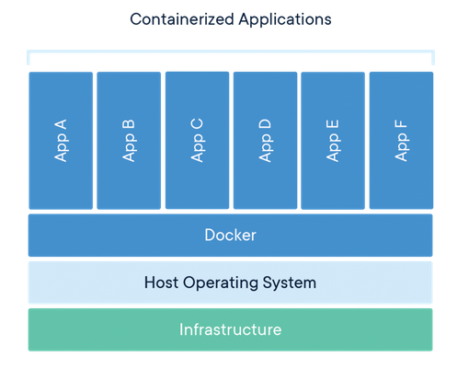
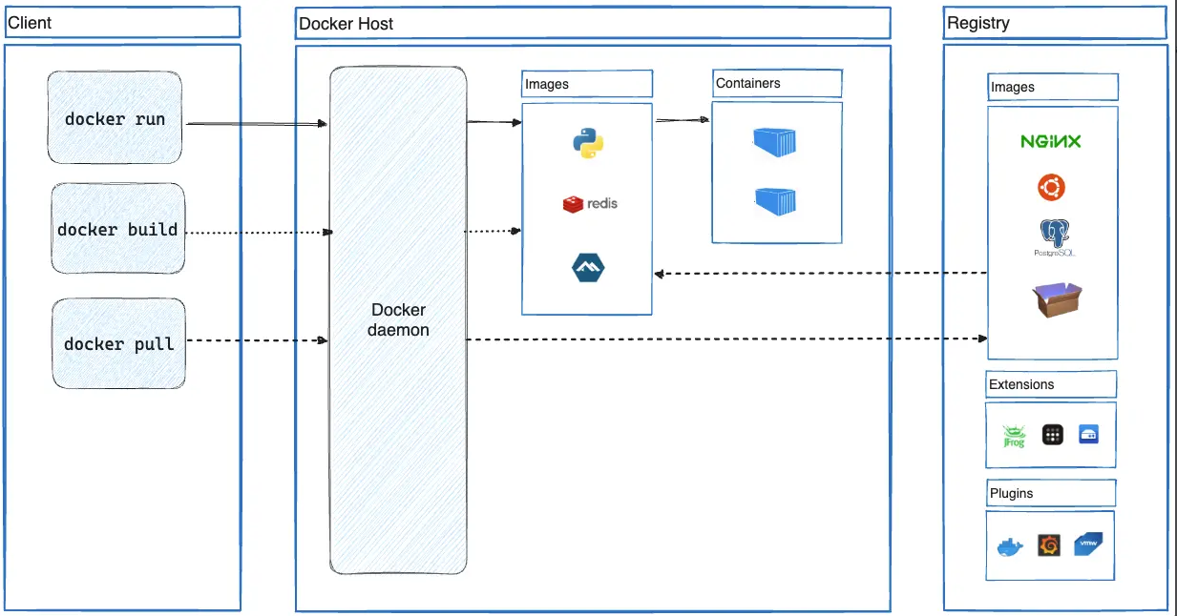
Docker Engine
Open-source containerization tool
Docker container:
Run-time environment with the applications to be run and their dependencies
Docker image:
Standalone and executable file that is used to create the container
Contains all files required (application, libraries, dependencies, etc.)
Sharable and portable
Source: https://www.docker.com/resources/what-container/
Source: https://docs.docker.com/guides/docker-overview/#docker-architecture

Slide 9
Docker workflow process
Step 1: Build the Docker image (Dockerfile)
Use a Dockerfile for easier defintion of the image to be built
Step 2: Load the Docker image as a container (load_dock.sh)
This is the main terminal of the container. Exiting from this terminal will unload the container.
No files will be saved in the container upon unloading.
Load and use a share volume from the host machine for saving work files.
Step 3: Access the running Docker container if more additional terminals are required (access_cont.sh)
Step 4: Exit from the container
Exiting from the main terminal will unload the container

Slide 10
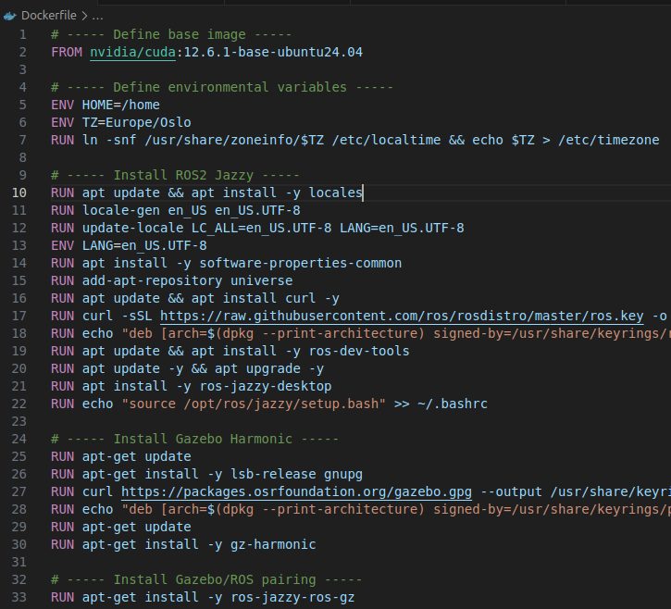
DockerFile
Base image
Example: nvidia/cuda:12.6.1-base-ubuntu24.04
https://hub.docker.com/r/nvidia/cuda
Reason: I am using a laptop that has NVIDIA RTX 2000 Ada. The Cuda base image has already many of the required graphics drivers pre-installed and configured.
Install packages
Sudo not required; the build process runs in root
Install ROS 2 jazzy, Gazebo harmonic, Gazebo/ROS pairing, misc ROS 2 tools and misc tools

Slide 11
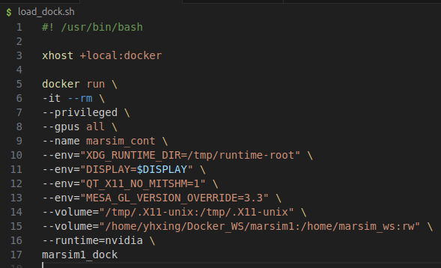
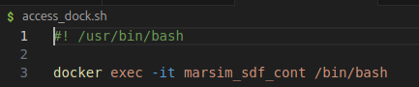
Load and run Docker container
load_dock.sh
load_dock.sh
xhost +local:docker: Allows the Docker container to access the host's X server for GUI applications.
Container options: -it: Interactive mode with a pseudo-TTY; --rm: Automatically remove the container when it exits; --privileged: Gives extended privileges to this container; --gpus all: Allows the container to use all available NVIDIA GPUs; --name marsim_sdf_cont: Names the container "marsim_sdf_cont".
Environment variables: XDG_RUNTIME_DIR=/tmp/runtime-root: Sets the runtime directory; DISPLAY=$DISPLAY: Passes the host's DISPLAY environment to the container; QT_X11_NO_MITSHM=1: Disables MIT-SHM extension for Qt applications: MESA_GL_VERSION_OVERRIDE=3.3: Forces OpenGL version 3.3 for Mesa drivers.
Volume mounts: /tmp/.X11-unix:/tmp/.X11-unix: Mounts X11 socket for GUI support; /home/yhxing/Docker_WS/marsim1:/home/marsim_ws:rw: Mounts a local directory into the container with read-write access;
--runtime=nvidia: Specifies to use the NVIDIA Container Runtime.
access_cont.sh
access_cont.sh

Slide 12
Some notes on load_dock.sh
If you do not have a Nvidia GPU on your host machine, remove --gpus all and --runtime=nvidia
Remember to change the volume mounting of the workspace directory to your own workspace directory

Slide 13
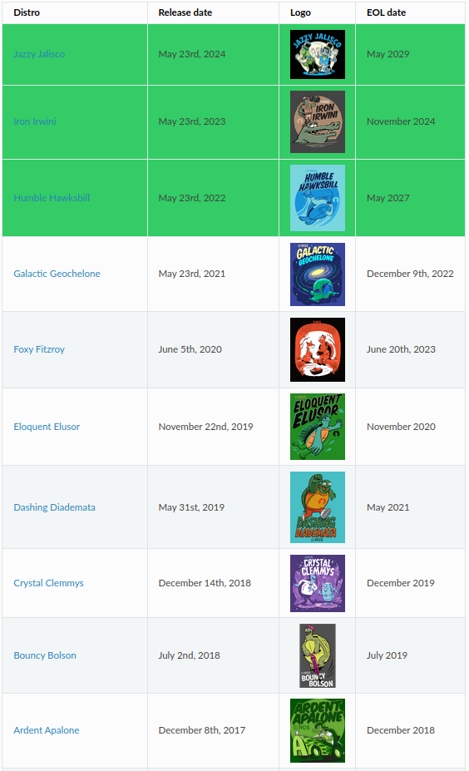
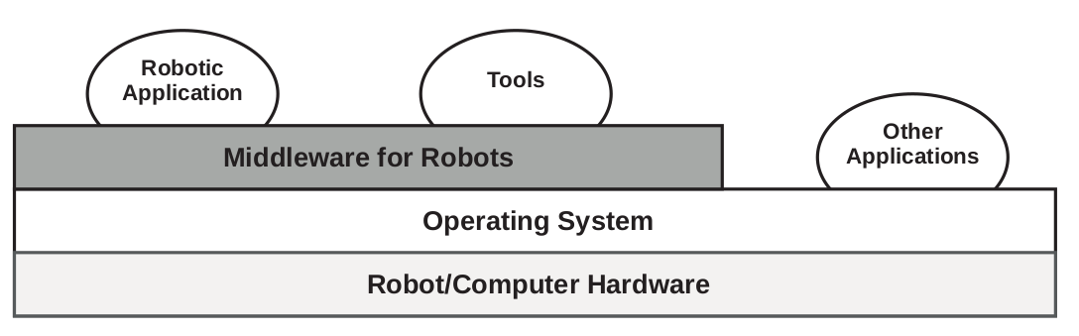
Robot Operating System 2 (ROS 2)
Material is taken from Rico, F. M. (2022). A concise introduction to robot programming with ROS 2. Chapman and Hall/CRC.
ROS 2 is not an operating system; it is a middleware developed and maintained by the Open Robotics Foundation
Middleware is a layer of software between the operating system and the user applications
ROS 2 is the 2nd generation of ROS
Source: Rico, F. M. (2022). A concise introduction to robot programming with ROS2. Chapman and Hall/CRC

Slide 14
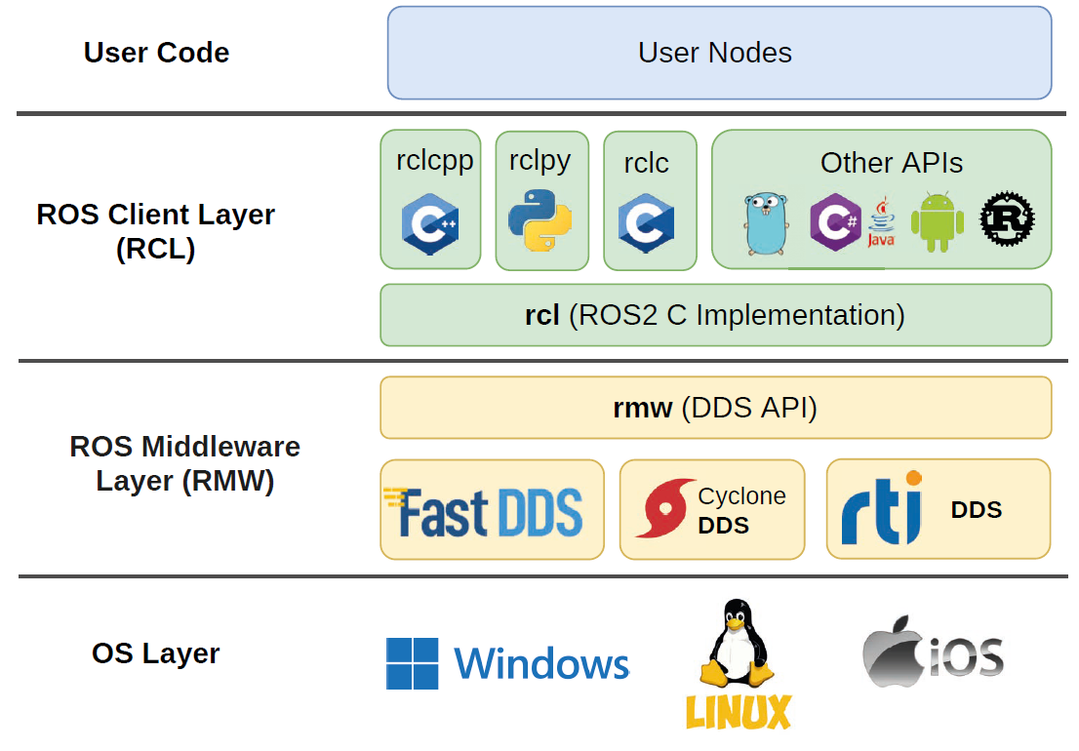
ROS 2 architecture
User nodes interface with ROS 2 via RCL’s APIs
rcl is the core of ROS 2 and is written in C
rclcpp, rclpy, rclc, etc binds different programming languages to rcl offering the same behaviour, i.e., they are not independent implementations
ROS 2 is a distributed system using data distribution system (DDS) as its communications layer
There are several DDS vendors; ROS 2 Humble uses Cyclone DDS
Source: Rico, F. M. (2022). A concise introduction to robot programming with ROS2. Chapman and Hall/CRC

Slide 15
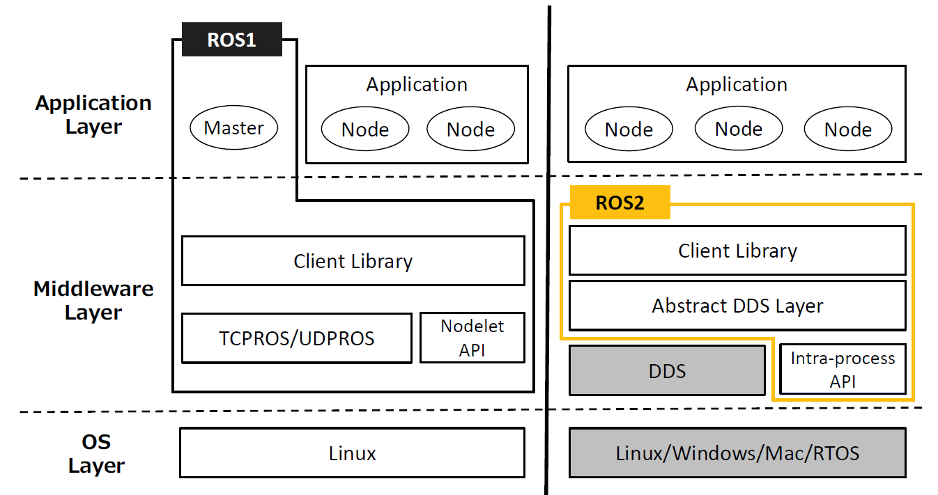
ROS 2 vs ROS 1
Architecture
DDS (ROS 2) vs Master-Slave Architecture and the XML-RPC middleware (ROS 1)
rcp with binders to any programming language (ROS 2) vs two seperate libraries roscpp and rospy (ROS 1)
Features
QoS, multi-threaded exectution and real-time processing
Tooling/Ecosystem
Not backward compatible, but interface with ROS 1 can be done via ROSbridge
Maruyama, Y., Kato, S., & Azumi, T. (2016, October). Exploring the performance of ROS2. In Proceedings of the 13th international conference on embedded software (pp. 1-10).

Slide 16
Components of ROS 2
ROS 2 is open source
The community
Large community of users and developers contributing software packages
Computation graph
ROS 2 runs as a computational graph consisting of nodes and arcs
Workspace
This is the user workspace that consists of the set of software installed on the robot or computer and the programs that the user develops

Slide 17
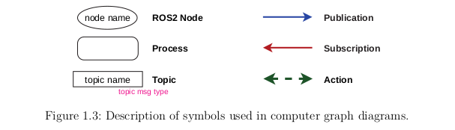
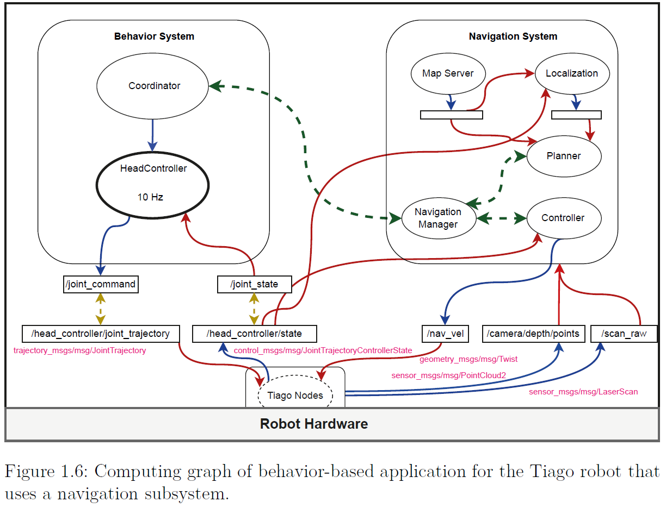
The computational graph
Node: single purpose executable program
Topic: a named bus over which nodes exchange messages
Publication/subscription: nodes sending/receiving messages on a topic
Service: a synchronous request/response interaction between nodes: must be completed before the next one begins
Action: an asynchronous request/response interaction with feedback; can be performed concurrently without waiting for each other to complete
Source: Rico, F. M. (2022). A concise introduction to robot programming with ROS2. Chapman and Hall/CRC

Slide 18
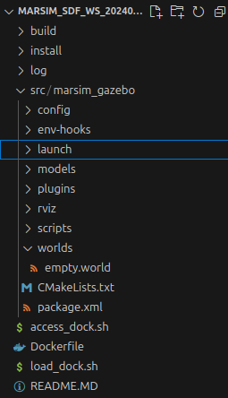
ROS 2 workspace
Workspace directory
Source code of user programs (packages) are stored in src
The workspace can contain multiple packages
Each package is stored in 1 directory with CMakeList.txt and package.xml
Workspace needs to be built using colcon build
build, install and log directories are created
To run the packages, the workspace needs to be sourced after building
source install/setup.bash

Slide 19
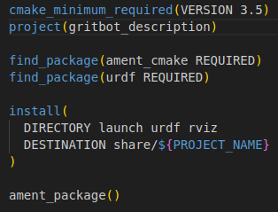
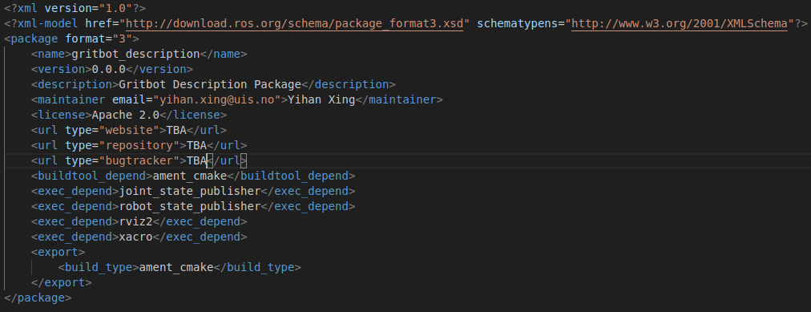
CMakeList.txt and package.xml
Must be placed at the root of the package directory
Defines the build tool, folders to be included, dependencies, etc

Slide 20
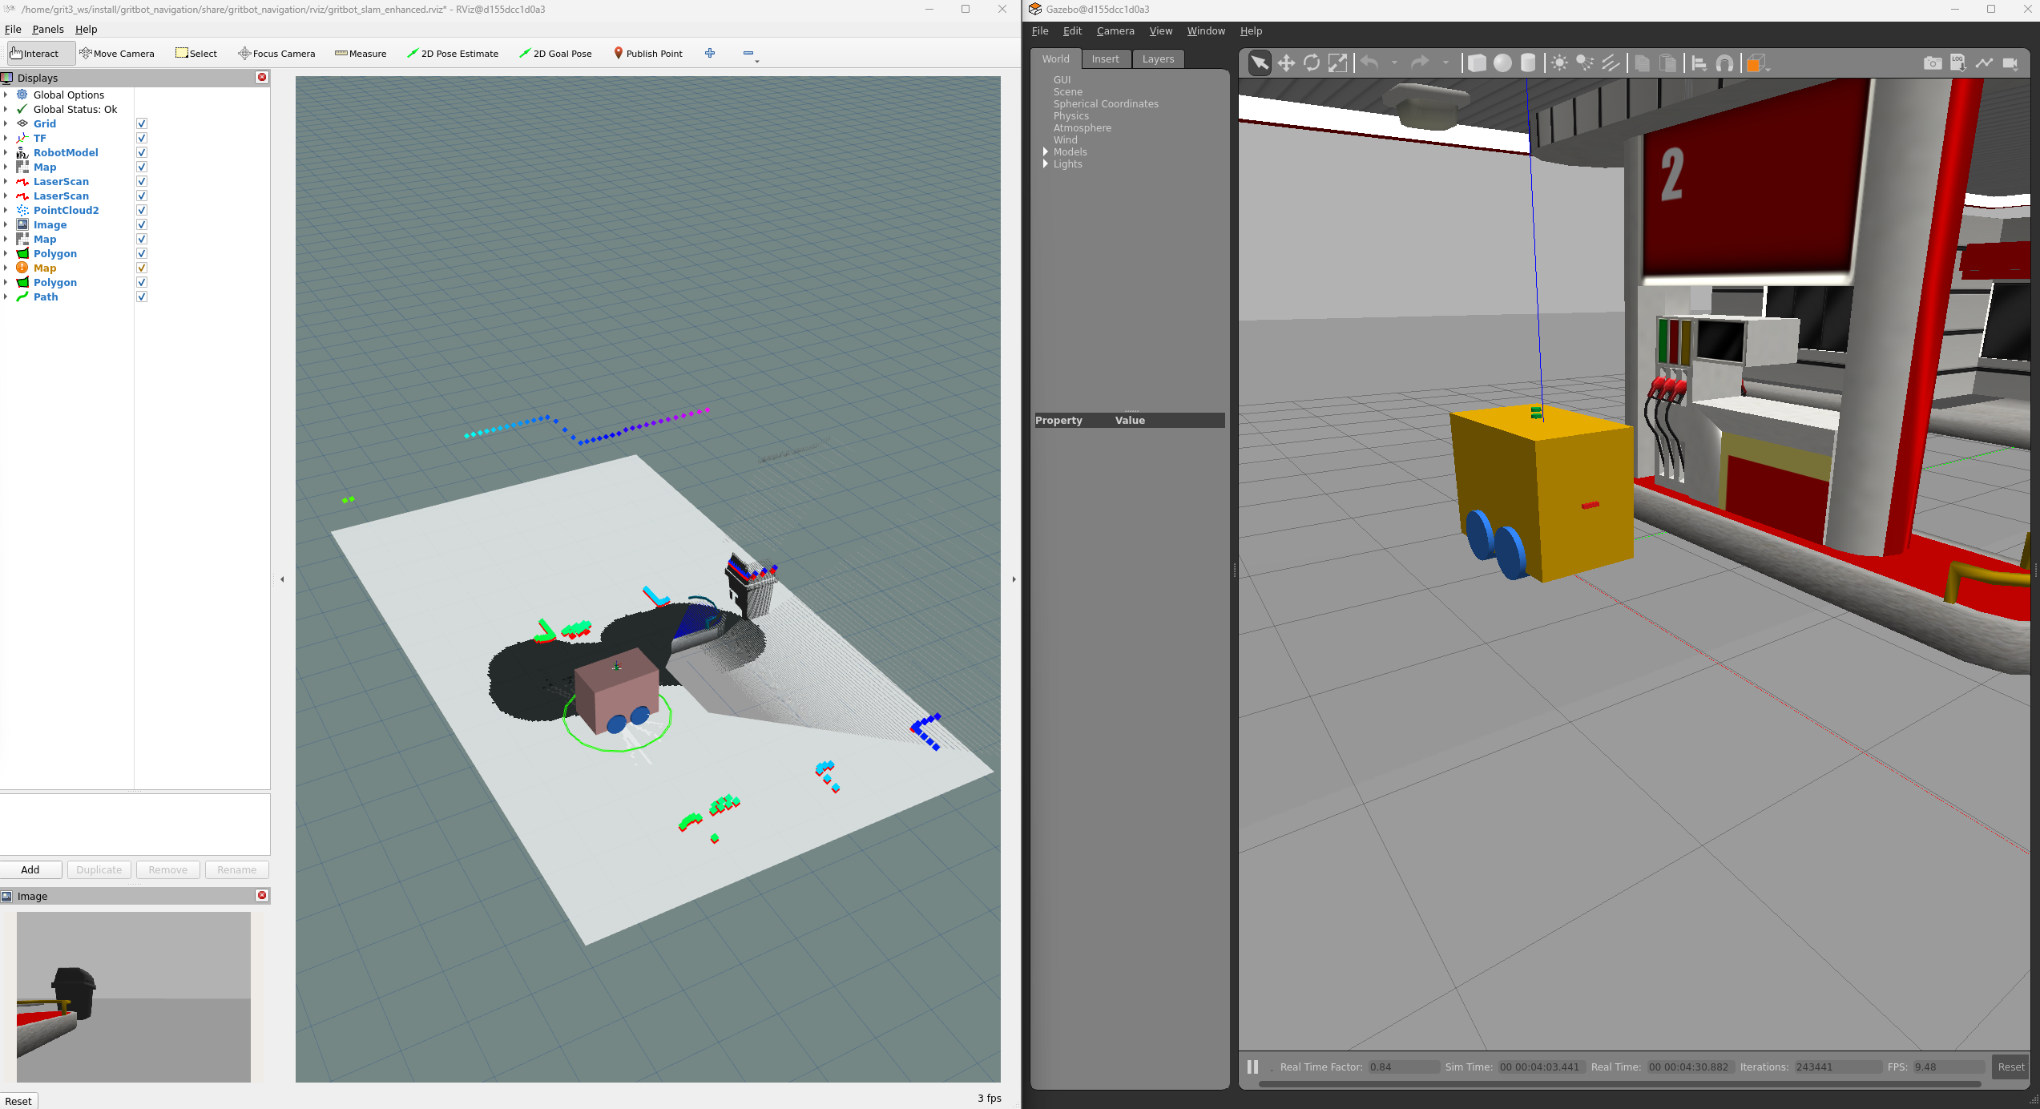
Rviz2
Port of Rviz to ROS2
Installed by ROS2 by default
Provides graphic interface for users to view the robot, sensor data, maps, etc

Slide 21
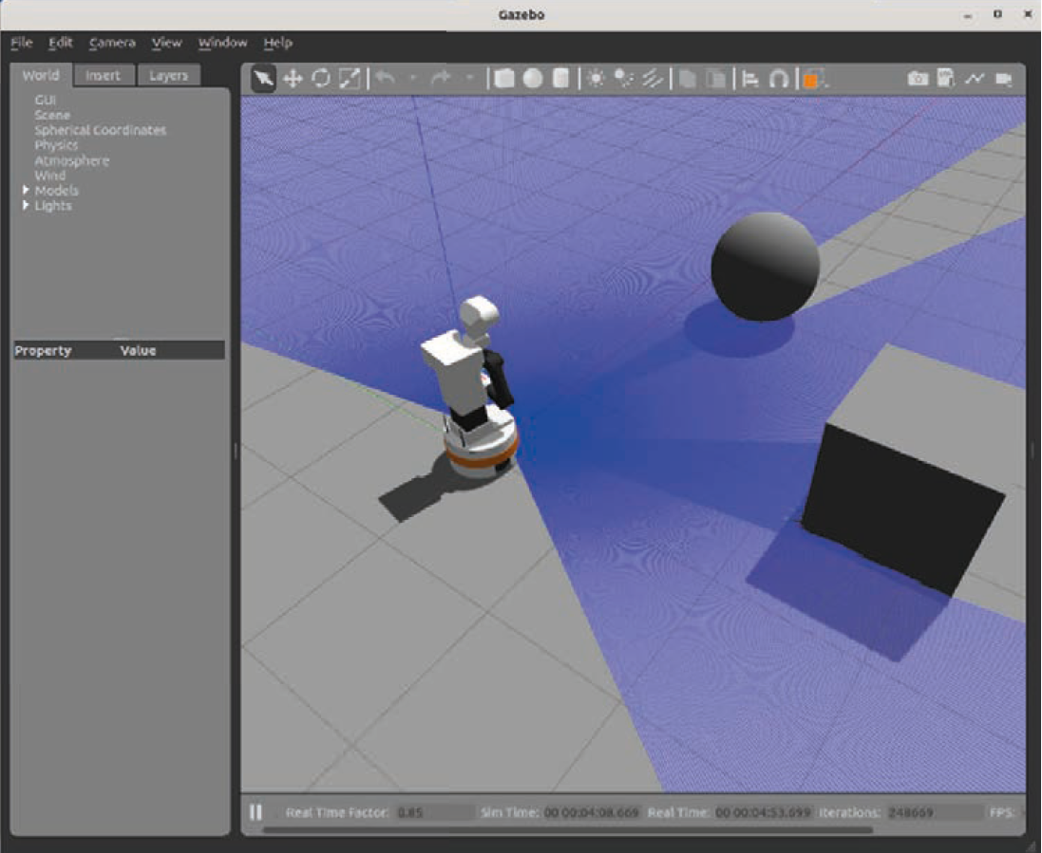
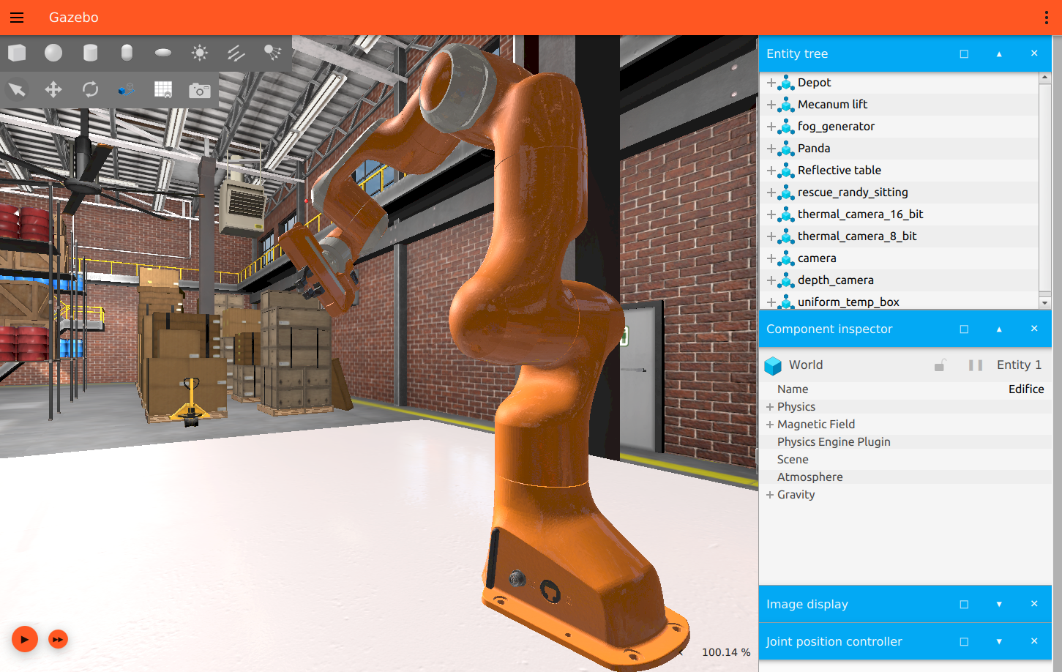
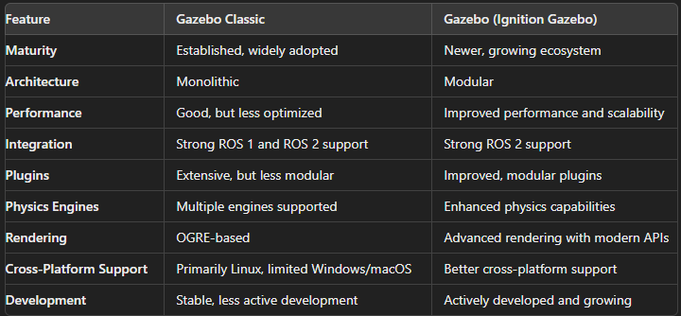
Gazebo
Open-source 3D robotics simulator developed and maintained by the Open Robotics Foundation
Commonly used together with ROS and ROS2
Features:
Physics engines: e.g., ODE, Bullet, Simbody and DART
3D graphics: uses Object-Oriented Graphics Rendering Engine
Sensors and actuators: e.g., lidar, IMU, cameras, GPS, etc
Plugins: easily extendable for custom functionalities
World and environment: allows for complex and dynamic environments
Multi-robot simulation
Gazebo classic and Gazebo (previously Ignition Gazebo)
We are using Gazebo Harmonic
Gazebo Classic. Source: Rico, F. M. (2022). A concise introduction to robot programming with ROS2. Chapman and Hall/CRC
Gazebo. Source: https://github.com/gazebosim

Slide 22
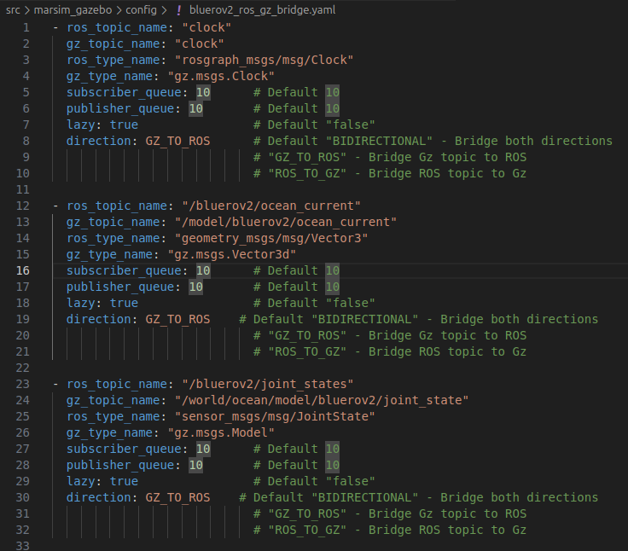
ros_gz_bridge
A network bridge which enables the exchange of messages between ROS 2 and Gazebo Transport
We need a bridge because the robot is simulated in Gazebo, while the robot is controlled in ROS2; the messages of the robot from Gazebo must be ported to ROS2
Limited to only certain message types
There are several ways to configure the bridge; we will use a yaml file, which is the easiest way

Slide 23
Marine Simulator Gazebo (marsim_gazebo) package
World
Standard Gazebo physics, user commands, scene broadcaster, imu, sensors, dvl system and buoyancy plugins
Seabed modelling using a heightmap model
Custom-written Gauss Markov ocean current plugin
Cuurently only BlueROV2 model - main body with 6 thursters
Buoyancy modelled using a rectangular collision geometry
Standard Gazebo hydrodynamic, joint state publisher, pose publisher and odometry publisher plugins
Thruster attached to main body using revolute joints with standard Gazebo thruster plugins
Standard Gazebo IMU and DVL sensors with a custom-written ccp plugins and python scripts for post processing of measurements
Simulated depth sensor using standard Gazebo odometry publisher with added noise using a custom-written python script
ROS2 robot description and robot localization packages
Custom-written python script for robot keyboard controller

Slide 24
Custom-written plugins and scripts
Source codes are stored in /plugins and /scripts
marsim_gazebo::GaussMarkovOceanCurrent
marsim_gazebo::DVLRosConverter
depth_sensor_from_odom.py
noisy_odometry.py
ros_keyboard_controller.py
twist_stamper.py

Slide 25
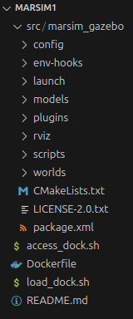
marsim1.2 ROS 2-Gazebo model
Currently only the marsim_gazebo package
config: holds the configuration files such as the roz_gz_bridge yaml file
env-hooks: holds the files required to define paths
launch: holds the python launch files
models: holds folders which contain the models in sdf format
plugins: holds the cpp source codes (cc and hh files) for custom-made Gazebo plugins
rviz: holds the Rviz2 configuration yaml files
scripts: holds scripts that can be used to control the BlueROV2
worlds: holds sdf world files

Slide 26
Starting up the model
ros2 launch marsim_gazebo empty_world.launch.py
ros2 launch marsim_gazebo spawn_bluerov2.launch.py
ros2 launch marsim_gazebo start_bridge.launch.py
ros2 launch marsim_gazebo complete_simlaunch_bluerov2.launch.py
ros run marsim_gazebo ros_keyboard_controller bluerov2

Slide 27
ROS2-GZ bridge
We need a bridge because ROS2 and Gazebo are separate programs
Recap:
ROS2 (Robot Operating System 2):
A flexible framework for writing robot software
Provides a collection of tools, libraries, and conventions for robot development
Handles communication between different parts of a robotic system
Supports multiple programming languages (C++, Python, etc.)
Designed for distributed computing and real-time systems
Used for both simulated and physical robots
Gazebo:
A 3D dynamic simulator for robots
Provides accurate simulation of robots in complex indoor and outdoor environments
Offers realistic sensor feedback and physically plausible interactions
Can simulate multiple robots
Often used in conjunction with ROS/ROS2 for testing and development

Slide 28
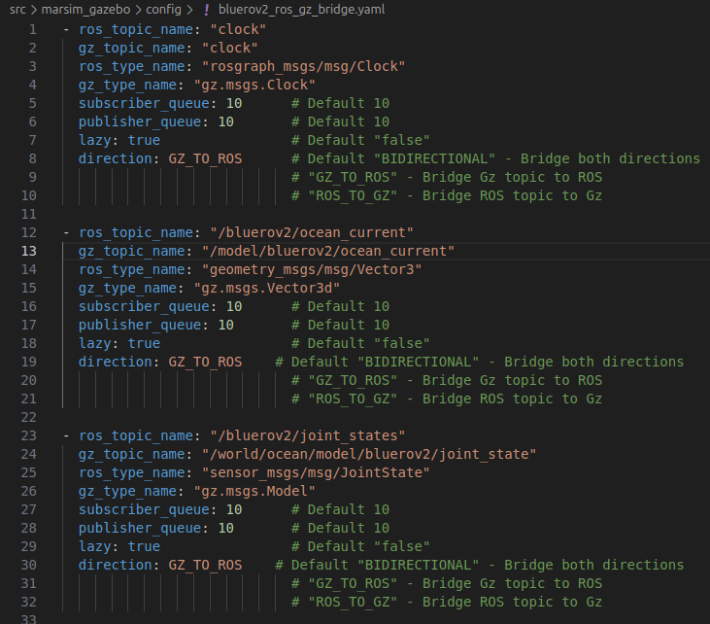
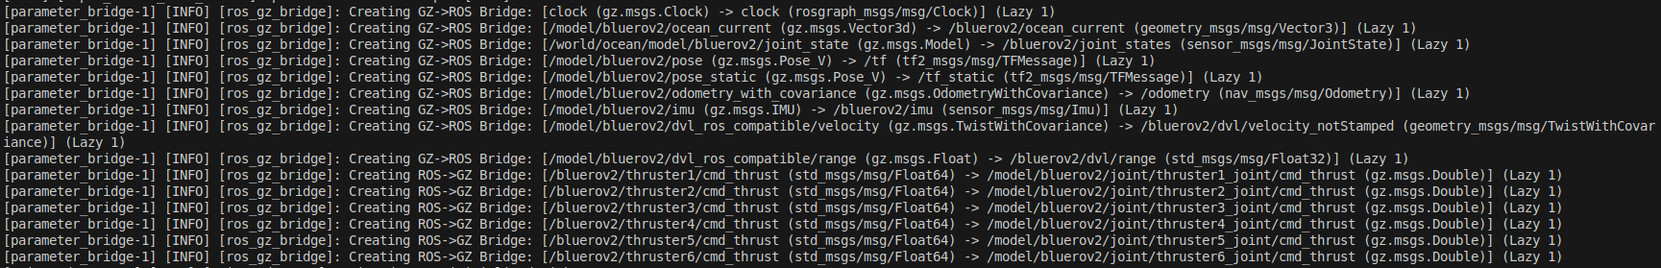
ROS 2-GZ bridge
Configured using bluerov2_ros_gz_bridge.yaml
Gazebo is the simulator, and ROS2 is the robot computer
Environment and robot measurements: Gazebo ---> ROS2
Robot commands: ROS2 ---> Gazebo

Slide 29
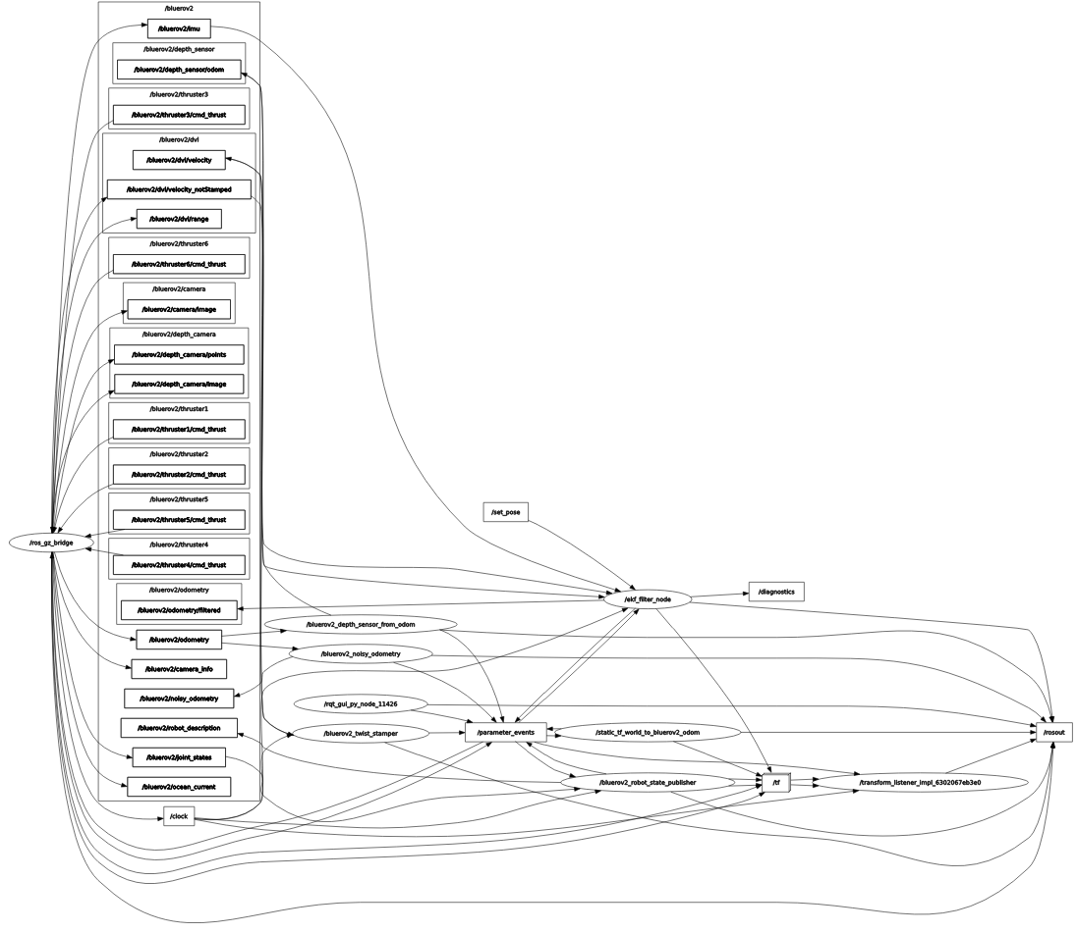
rqt_graph
Namespace: bluerov2
Important nodes
/ros_gz_bridge
/ekf_filter
/robot_state_publisher
/depth_sensor_from_odom
/noisy_odometry
/twist_stamper
Important topics
/bluerov2
/tf
/robot_description
odometry
odometry/filtered

Slide 30
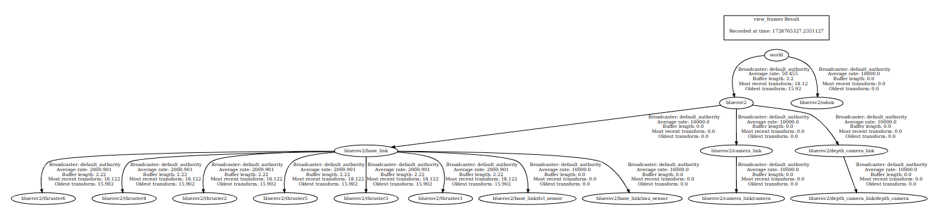
TF2 tree
No bluerov2/base_link/depth_sensor because the depth sensor is simulated using pose z measurements from /odometry with gaussian noise added

Slide 31
EKF – Robot Localization package
Implemented using ROS 2 robot localization package
Configured using bluerov2_ekf_config.yaml
imu0: standard Gazebo IMU sensor
Orientations, angular velocities, linear accelerations
twist0
Linear velocities
odom0
Only pose z
Can be tuned through the defintion of the covariances

Slide 32
EKF - Introduction
Purpose: State estimation for nonlinear systems
Estimates the state of a dynamic system from noisy measurements
Crucial for robotics, autonomous systems, and control applications
Extends the linear Kalman Filter to nonlinear systems
Uses local linearization around the current state estimate
Key applications:
Robot localization and navigation
Sensor fusion in autonomous vehicles
Spacecraft attitude determination
Target tracking in radar systems
Addresses challenges of:
System nonlinearity
Measurement and process noise
Multi-sensor integration

Slide 33
EKF algorithm
The EKF algorithm aims to estimate the full 3D pose and velocity (6 pose states and 6 velocity states) of the robot over time
Consists of two steps: prediction and update
For more details, see Moore, T., & Stouch, D. (2016). A generalized extended kalman filter implementation for the robot operating system. In Intelligent Autonomous Systems 13: Proceedings of the 13th International Conference IAS-13 (pp. 335-348). Springer International Publishing.

Slide 34
EKF algorithm – Robot state and measurements
Robot state: x_{k} = f(x_{k-1}) + w_{k-1}
x_{k} is the 12-dimensional state vector (x, y, z, roll, pitch, yaw, vx, vy, vz, wx, wy, wz) at time k
f is the nonlinear state transition function
w_{k-1} is the process noise at time k-1 which is assumed to be normally distrubuted
Measurements: z_{k} = h(x_{k}) + v_{k}
z_{k} is the measurement at time k
h is the nonlinear sensor model that maps the states into the measurement space
v_{k} is the normally distributed sensor noise

Slide 35

EKF algorithm – Prediction step
Project the current state estimate and error covariance forward in time:
State prediction: est(x_{k}) = f(x_{k-1})
est(x_{k}) is the estimate of the state at time k
f is robot model or nonlinear state transition function
x_{k-1} is the state at time k-1
Covariance prediction: est(P_{k}) = FP_{k-1}F^{T} + Q
est(P_{k}) is the estimated error covariance projected via F and perturbed by Q
F is the Jacobian of f
Q is the process noise covariance

Slide 36
EKF algorithm – Correction step
Kalman gain calculation: K = est(P_{k})H^{T}(H est(P_{k})H^{T} + R)⁻¹
K is the Kalman gain
H is the observation matrix, the Jacobian of h, the observation model function or the nonlinear sensor model. To support a wide array of sensors, H is an identity matrix in the robot_localization package.
R is the measurement covariance
State update: x_{k} = est(x_{k}) + K(z – H est(x_{k}))
Covariance update: P_{k} = (I - KH) est(P_{k})(I – KH)^{T} + KRK^{T}

Slide 37
EKF algorithm – Prediction step (more explanations)
State prediction: est(x_{k}) = f(x_{k-1})
This equation projects the state estimate forward in time
f represents the robot's motion model. For example, if the robot is moving at a certain velocity, f would use this information to predict where the robot will be at the next time step.
The key point here is that f can be nonlinear, which is what distinguishes the Extended Kalman Filter from the regular Kalman Filter. This allows it to handle more complex systems and motions.

Slide 38
EKF algorithm – Prediction step (more explanations) (2)
Covariance prediction: est(P_{k}) = FP_{k-1}F^{T} + Q
F is the Jacobian of f and represents how changes in the previous state affect the current state. It's used to transform the previous covariance into the new time step. The use of the Jacobian F is another key aspect of the Extended Kalman Filter. It's a linear approximation of how the nonlinear function f behaves near the current estimate. This linearization is what allows the EKF to apply the Kalman Filter framework to nonlinear systems.
FP_{k-1}F^{T} propagates the previous uncertainty through the state transition model.
Q adds additional uncertainty due to imperfections in our model or external factors we can't account for.

Slide 39
EKF algorithm – Correction step (more explanations)
Kalman gain calculation: K = est(P_{k})H^{T}(H est(P_{k})H^{T} + R)⁻¹
est(P_{k})H^{T} represents how much we expect the measurement to change based on changes in our state estimate
H est(P_{k})H^{T} + R represents the total expected variance in our measurement (predicted measurement uncertainty + actual measurement noise).
The inverse at the end turns this into a ratio - effectively, "how much should we trust this measurement compared to our prediction?
State update: x_{k} = est(x_{k}) + K(z – H est(x_{k}))
z – H est(x_{k})) is the difference between the actual measurement z and what we expected to measure K(z – H est(x_{k})). This is often called the "innovation" or "measurement residual".
We multiply this difference by K to determine how much to adjust our prediction. If K is large, we adjust our estimate more towards the new measurement. If K is small, we trust our prediction more.

Slide 40
EKF algorithm – Correction step (more explanations) (2)
Covariance update: P_{k} = (I - KH) est(P_{k})(I – KH)^{T} + KRK^{T}
I – KH represents how much of our previous uncertainty estimate we're keeping. If K is large (we trusted the measurement a lot), this term becomes smaller.
est(P_{k})(I – KH)^{T} reduces our uncertainty based on how much information we gained from the measurement
KRK^{T} adds back some uncertainty based on how noisy our measurement was

Slide 41
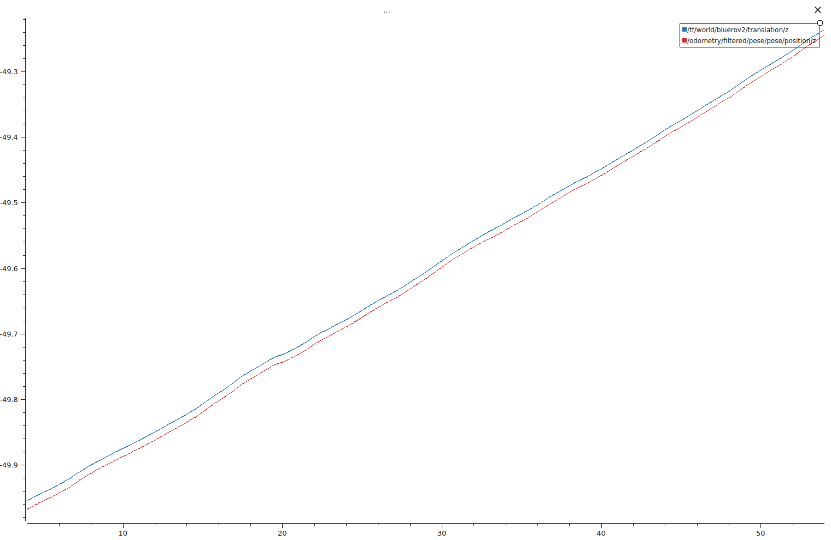
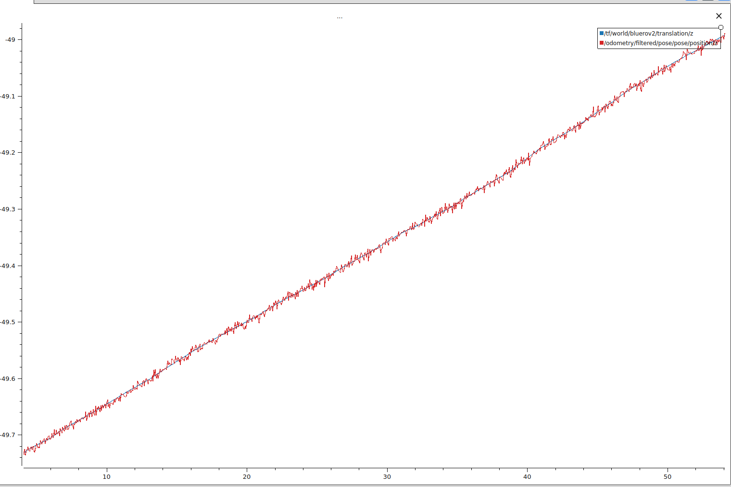
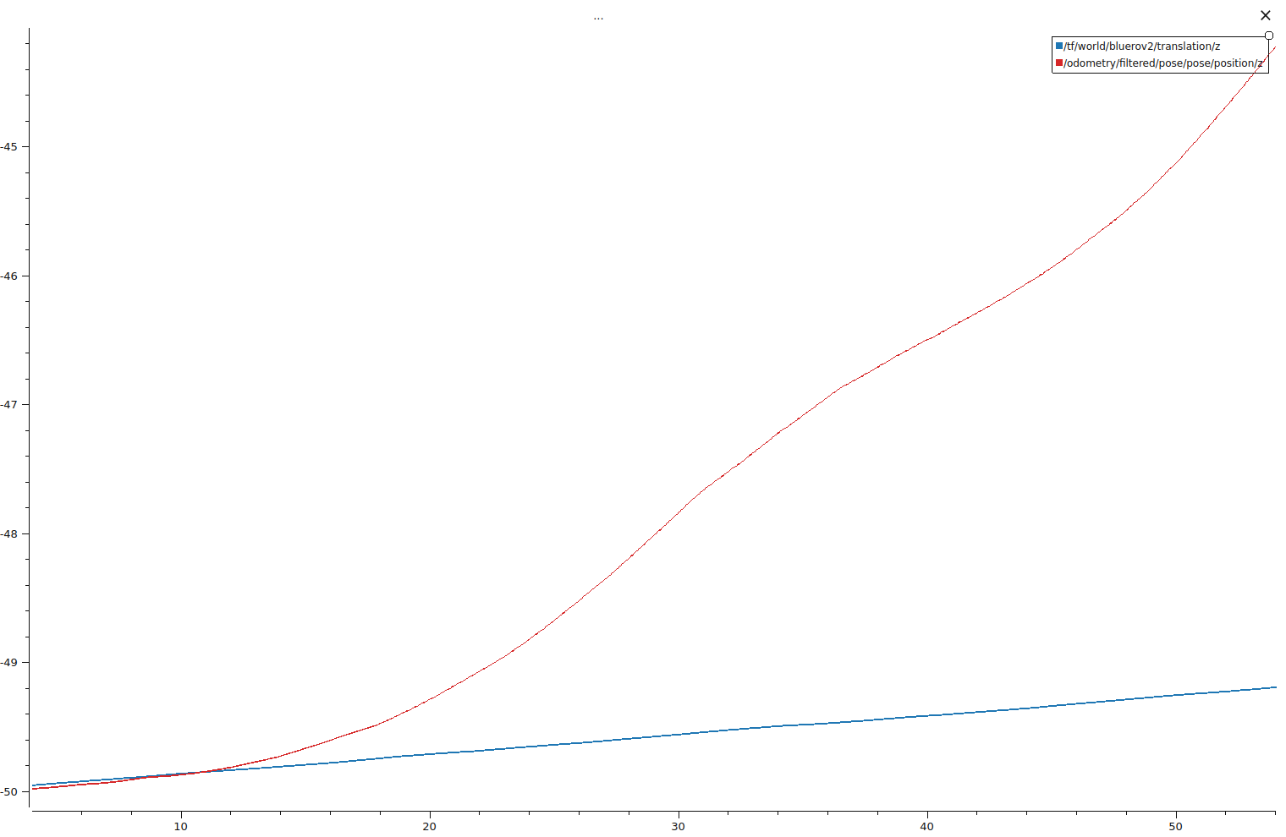
State estimations of position z when different combination of sensors are used
A much smaller drift in the state estimation due to DVL sensor providing vz measurements which require only single time integration
Red line = estimated depth; Blue line = actual depth
IMU + DVL + Depth sensors
IMU + DVL sensors
The state estimation track readings of the depth sensor closely as it provides direct z measurements
Huge drift in the state estimation due to accumulated error from the double time integration of az
Measurements from the sensors:
IMU: ax, ay, az, ωx, ωy, ωz
DVL: vx, vy, vz
Depth: z
IMU sensor only

Slide 42
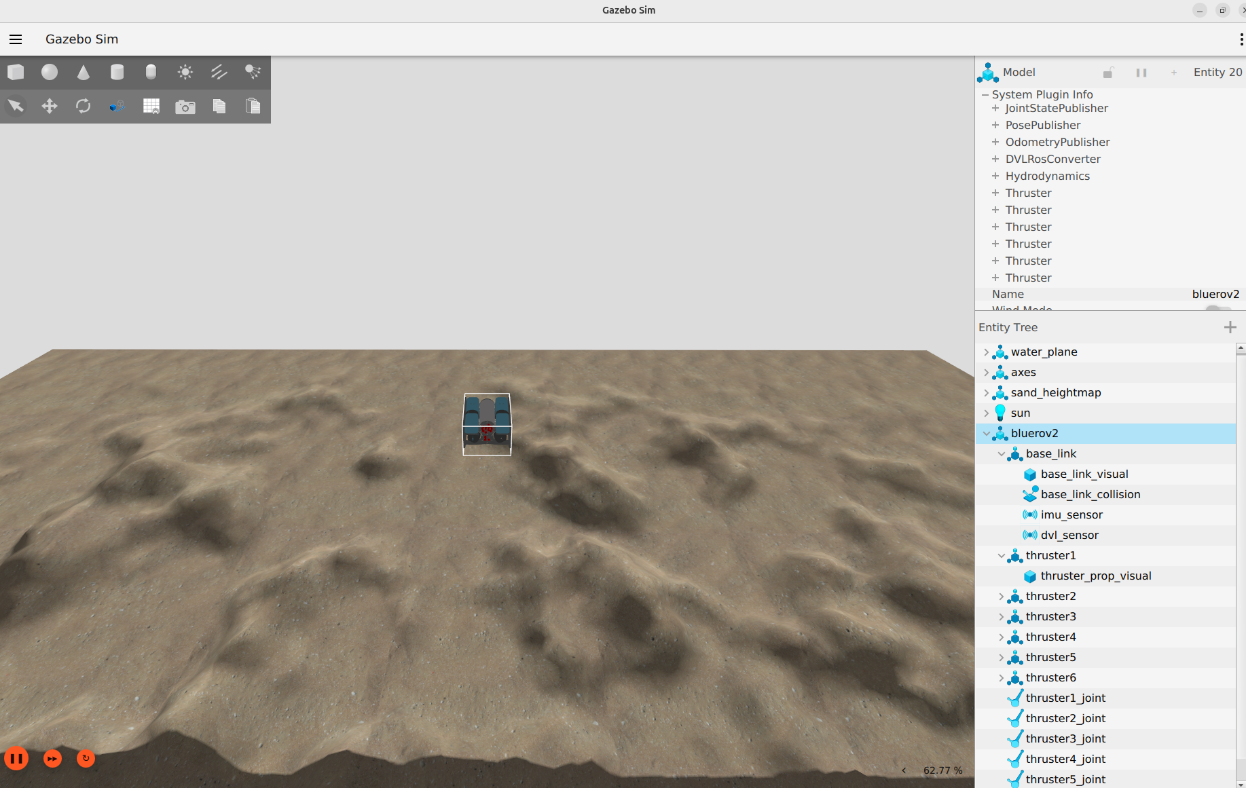

Slide 43
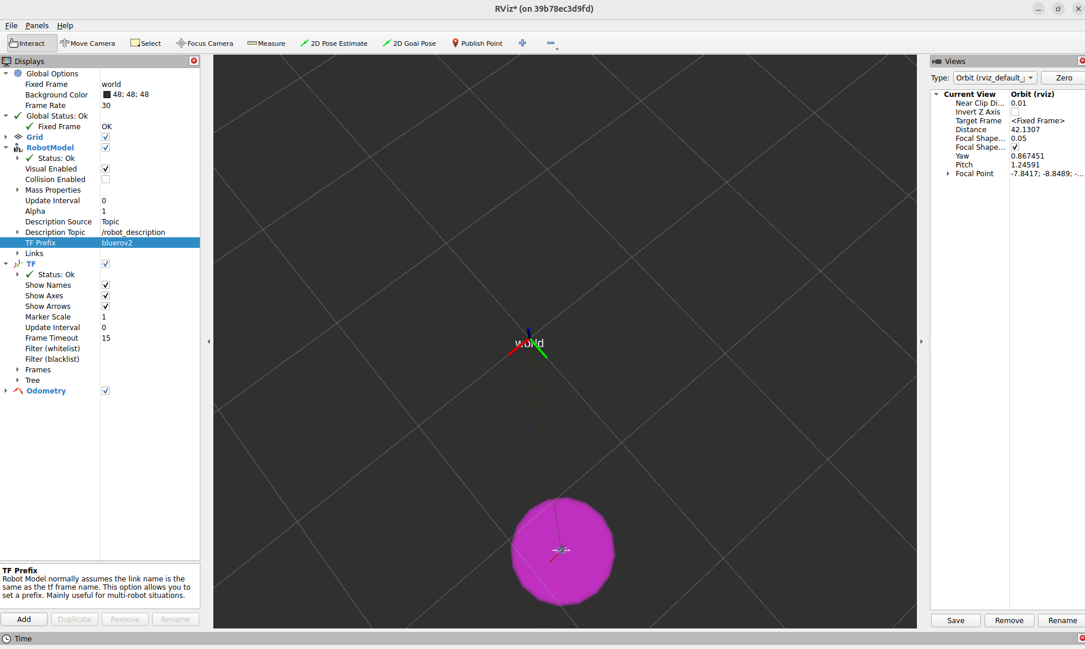

Slide 44
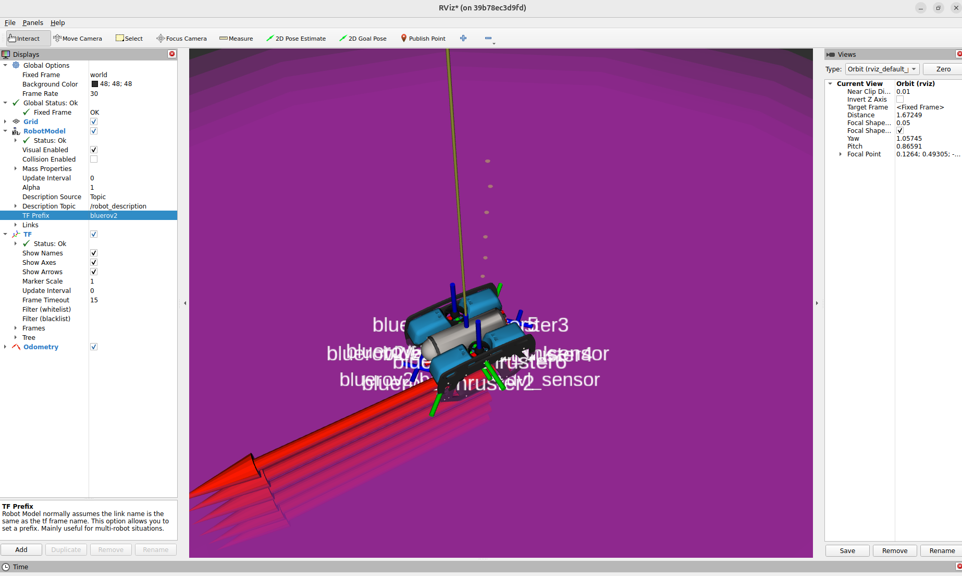

Slide 45
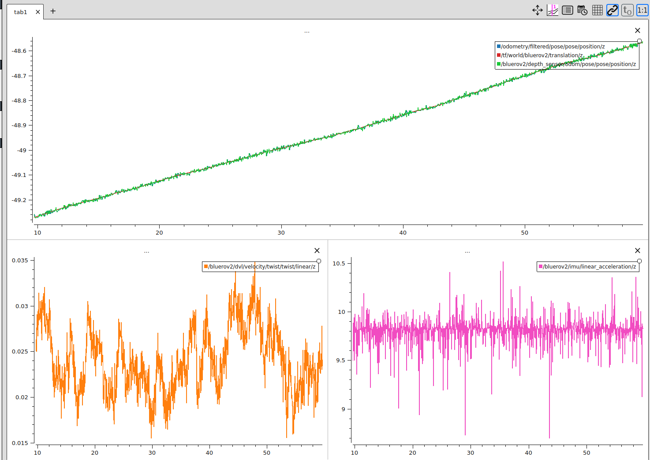

Slide 46
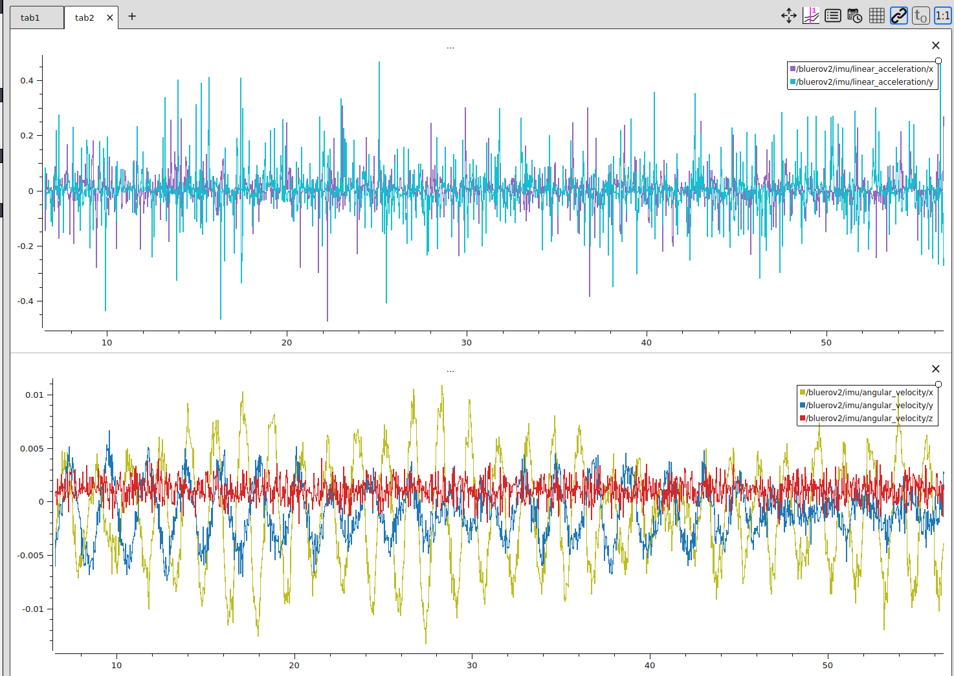

Slide 47
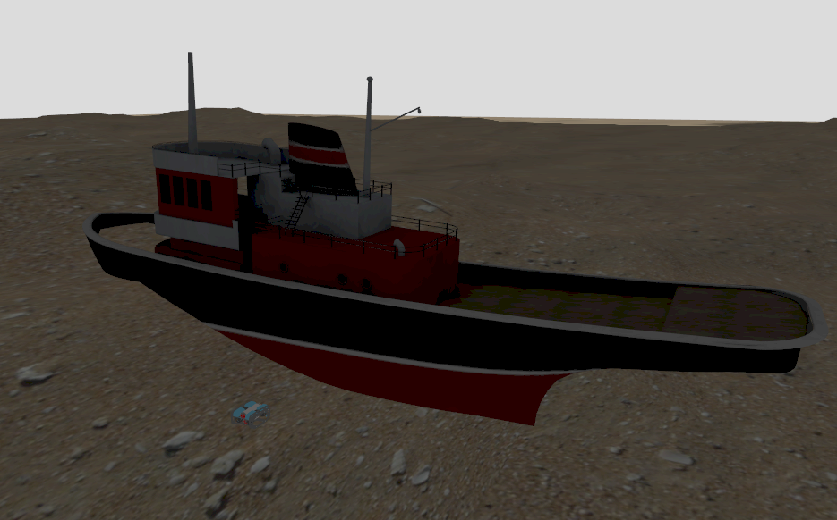
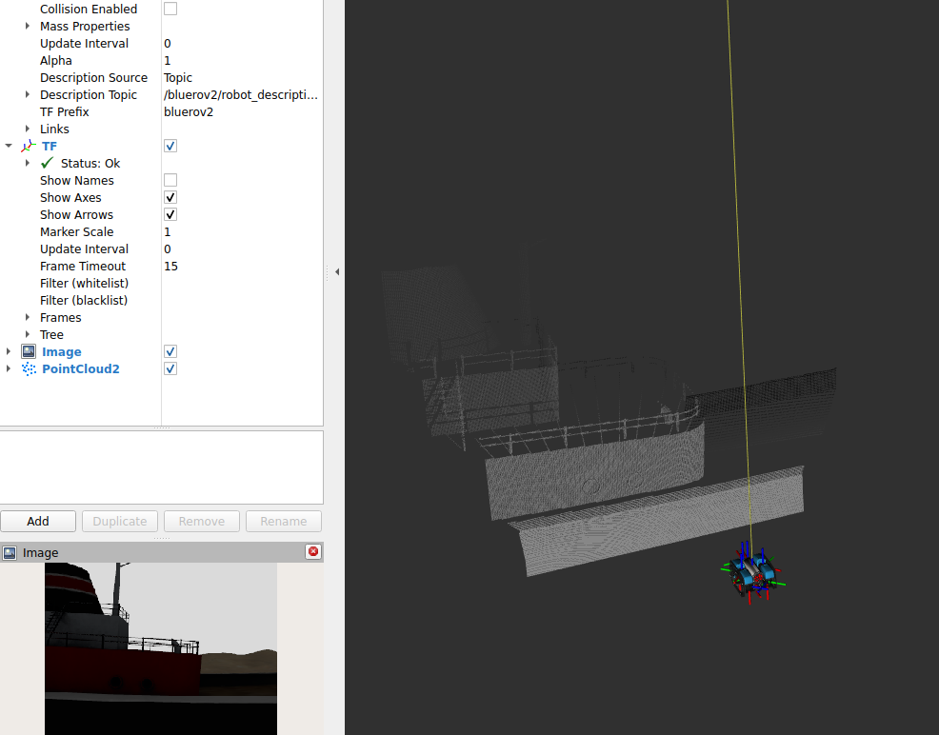
With camera and depth camera sensors

Slide 48
Marine Simulator Control (marsim_control) package
Package where control-related source code will be placed
Common scripts where common functions are placed
marsim_control/bluerov2_utils.py
marsim_control/marsim_utils.py
Control scripts for BlueROV2
Two types of control commands
_control: a target position is given as command
_reqcontrol: a target change in position is given as command
Z position control:
scripts/bluerov2_pid_pose_z_control.py
scripts/bluerov2_pid_pose_z_reqcontrol.py
T1 to T4 are set to None
X, Y and Yaw control
scripts/bluerov2_pid_pose_xyyaw_reqcontrol.py
T5 and T6 are set to None
scripts/bluerov2_stop_thrusters.py

Slide 49
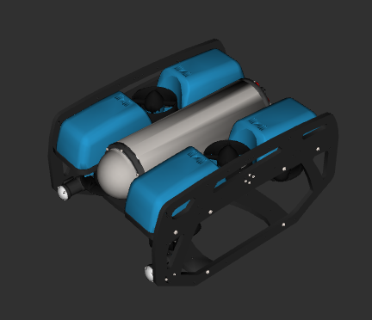
BlueROV2 thruster control configuration
z
For thruster control, the BlueROV2 has:
12 State vector components:
Position (x, y, z)
Orientation (roll, pitch, yaw)
Linear velocity (vx, vy, vz)
Angular velocity (ωx, ωy, ωz)
6 input vector components:
Commands for 6 thrusters
x
T2
T1
x
y
y
T6
T5
Positive thrust for T5 and T6 is pointing upwards, i.e., pushes the ROV downwards
T4
T3
Z-axis pointing out of the paper

Slide 50
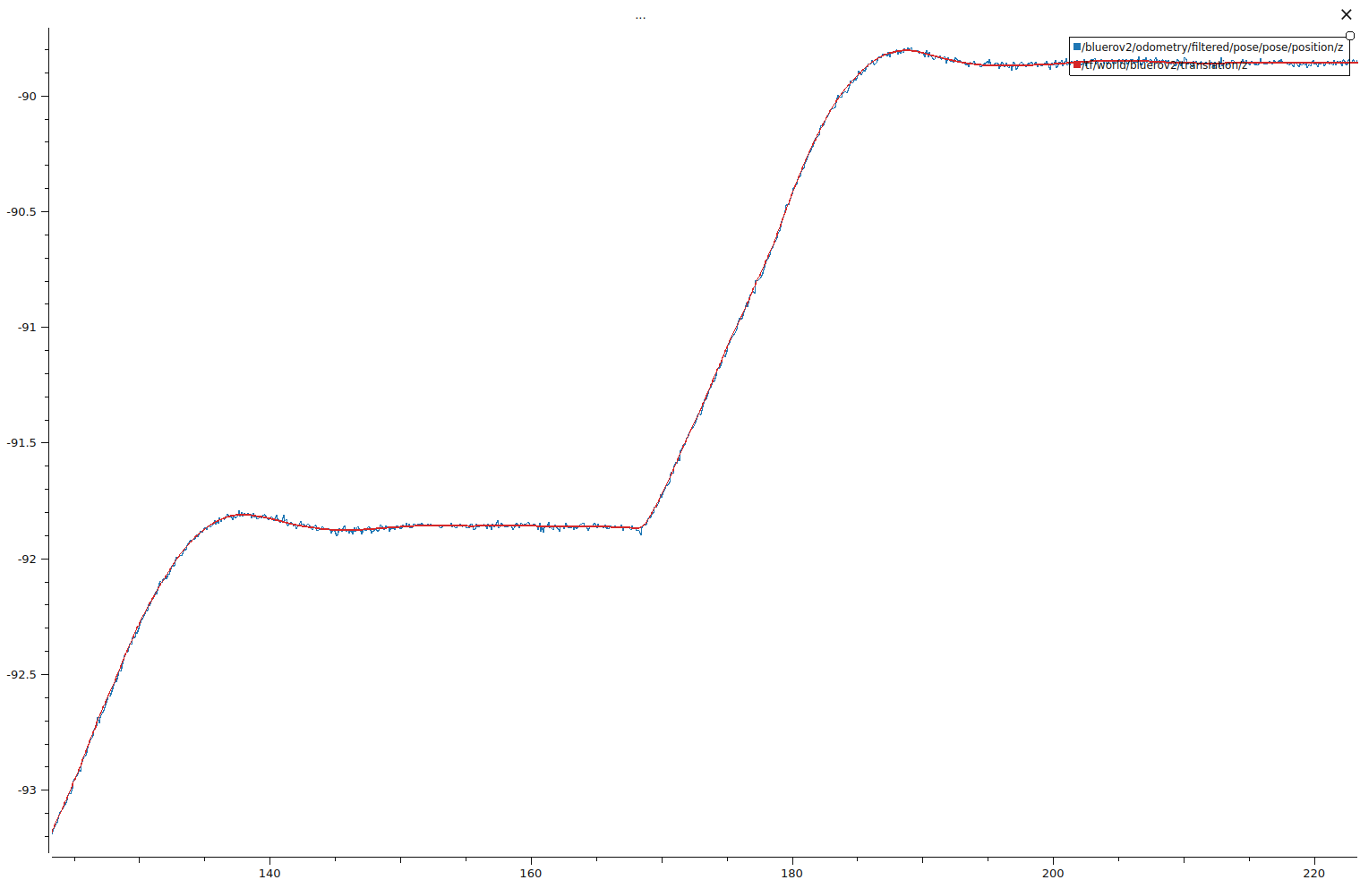
PID depth control:
scripts/bluerov2_pid_pose_z_control.py
Target z coordinate is provided as command
Going from –92 m to –90 m
scripts/bluerov2_pid_pose_z_reqcontrol.py also performs the same task except that a requested displacement in z in provided as command

Slide 51
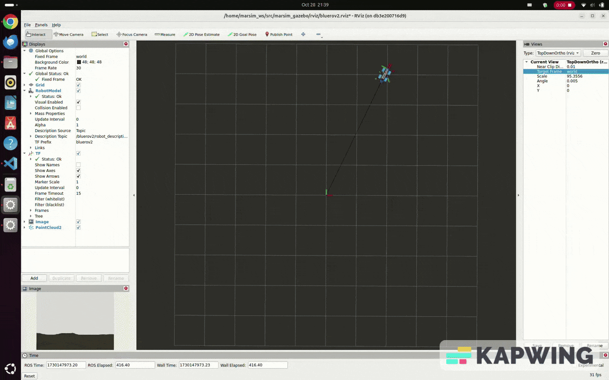
PID x, y and yaw control:
scripts/bluerov2_pid_pose_xyyaw_reqcontrol.py
Uses state machines
Rotate to required yaw heading
Move forward to request x and y
Rotate to final requested yaw heading

Slide 52
Planned updates for MARSIM v1.3
Separate the documentation ppt into the different packages
ROS 2-Gazebo ECIU workshop materials

Slide 53
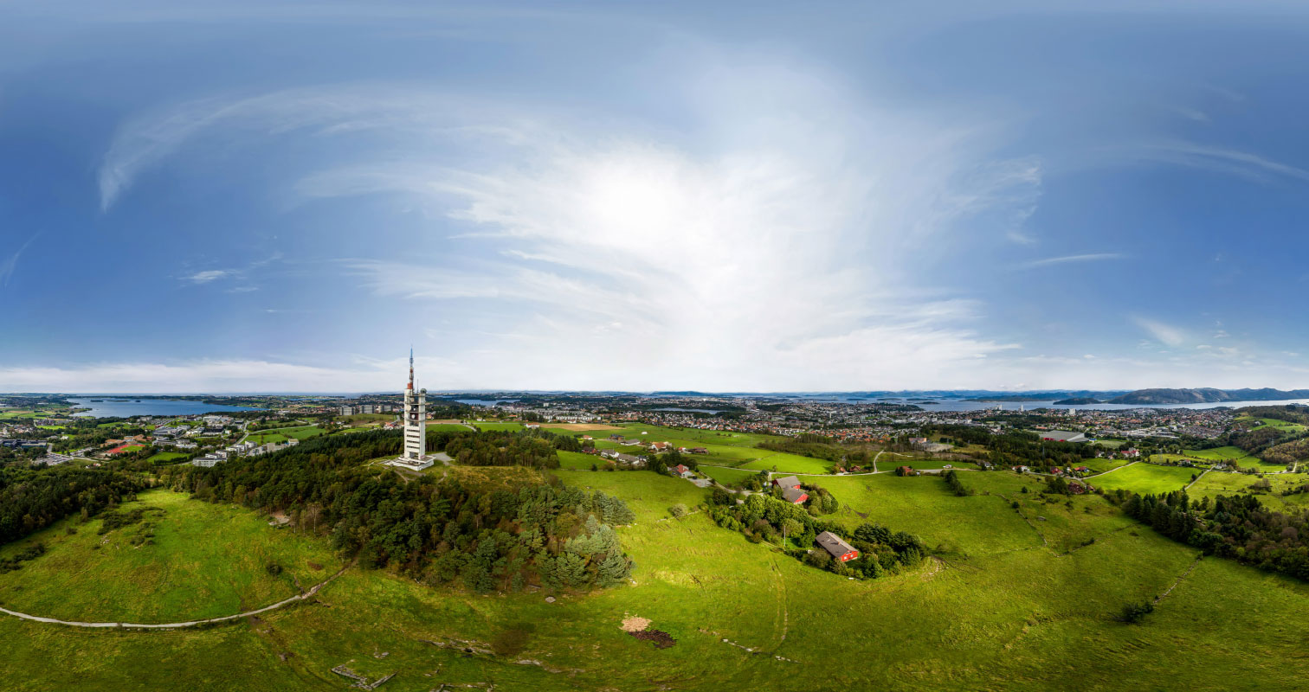
Thank you for your attention!

